Slide 1
Cloud Deployment Models

Slide 2
Introduction
The cloud deployment model identifies the specific type of cloud environment based on ownership, scale, and access, as well as the cloud’s nature and purpose.
The location of the servers you’re utilizing and who controls them are defined by a cloud deployment model.
It specifies how your cloud infrastructure will look, what you can change, and whether you will be given services or will have to create everything yourself.
Relationships between the infrastructure and your users are also defined by cloud deployment types.

Slide 3
Types of cloud computing deployment models
Public cloud
Private cloud
Hybrid cloud
Community cloud
Multi-cloud

Slide 4
Public Cloud
The public cloud makes it possible for anybody to access systems and services. The public cloud may be less secure as it is open for everyone.
The public cloud is one in which cloud infrastructure services are provided over the internet to the general people or major industry groups. The infrastructure in this cloud model is owned by the entity that delivers the cloud services, not by the consumer.
It is a type of cloud hosting that allows customers and users to easily access systems and services.

Slide 5
Advantages of Public Cloud
Minimal Investment: Because it is a pay-per-use service, there is no substantial upfront fee, making it excellent for enterprises that require immediate access to resources.
No setup cost: The entire infrastructure is fully subsidized by the cloud service providers, thus there is no need to set up any hardware.
Infrastructure Management is not required: Using the public cloud does not necessitate infrastructure management.
No maintenance: The maintenance work is done by the service provider (Not users).
Dynamic Scalability: To fulfil your company’s needs, on-demand resources are accessible.

Slide 6
Private Cloud
The private cloud deployment model is the exact opposite of the public cloud deployment model. It’s a one-on-one environment for a single user (customer).
There is no need to share your hardware with anyone else. The distinction between private and public cloud is in how you handle all of the hardware. It is also called the “internal cloud” & it refers to the ability to access systems and services within a given border or organization.
The cloud platform is implemented in a cloud-based secure environment that is protected by powerful firewalls and under the supervision of an organization’s IT department

Slide 7
Advantages of Private Cloud
Better Control: You are the sole owner of the property. You gain complete command over service integration, IT operations, policies, and user behaviour.
Data Security and Privacy: It’s suitable for storing corporate information to which only authorized staff have access. By segmenting resources within the same infrastructure, improved access and security can be achieved.
Supports Legacy Systems: This approach is designed to work with legacy systems that are unable to access the public cloud.
Customization: Unlike a public cloud deployment, a private cloud allows a company to tailor its solution to meet its specific needs.

Slide 8
Hybrid Cloud
By bridging the public and private worlds with a layer of proprietary software, hybrid cloud computing gives the best of both worlds.
With a hybrid solution, you may host the app in a safe environment while taking advantage of the public cloud’s cost savings.
Organizations can move data and applications between different clouds using a combination of two or more cloud deployment methods, depending on their needs

Slide 9
Advantages of Hybrid Cloud
Flexibility and control: Businesses with more flexibility can design personalized solutions that meet their particular needs.
Cost: Because public clouds provide for scalability, you’ll only be responsible for paying for the extra capacity if you require it.
Security: Because data is properly separated, the chances of data theft by attackers are considerably reduced.

Slide 10
Community Cloud
It allows systems and services to be accessible by a group of organizations.
It is a distributed system that is created by integrating the services of different clouds to address the specific needs of a community, industry, or business.
The infrastructure of the community could be share between the organization which has shared concerns or tasks.
It is generally managed by a third party or by the combination of one or more organizations in the community.

Slide 11
Advantages of Community Cloud
Cost Effective: It is cost-effective because the cloud is shared by multiple organizations or communities.
Security: Community cloud provides better security.
Shared resources: It allows you to share resources, infrastructure, etc. with multiple organizations.
Collaboration and data sharing: It is suitable for both collaboration and data sharing.

Slide 12
Multi-Cloud
We’re talking about employing multiple cloud providers at the same time under this paradigm, as the name implies.
It’s similar to the hybrid cloud deployment approach, which combines public and private cloud resources.
Instead of merging private and public clouds, multi-cloud uses many public clouds.
Although public cloud providers provide numerous tools to improve the reliability of their services, mishaps still occur.

Slide 13
Advantages of Multi-Cloud
You can mix and match the best features of each cloud provider’s services to suit the demands of your apps, workloads, and business by choosing different cloud providers.
Reduced Latency: To reduce latency and improve user experience, you can choose cloud regions and zones that are close to your clients.
High availability of service: It’s quite rare that two distinct clouds would have an incident at the same moment. So, the multi-cloud deployment improves the high availability of your services.

Slide 14
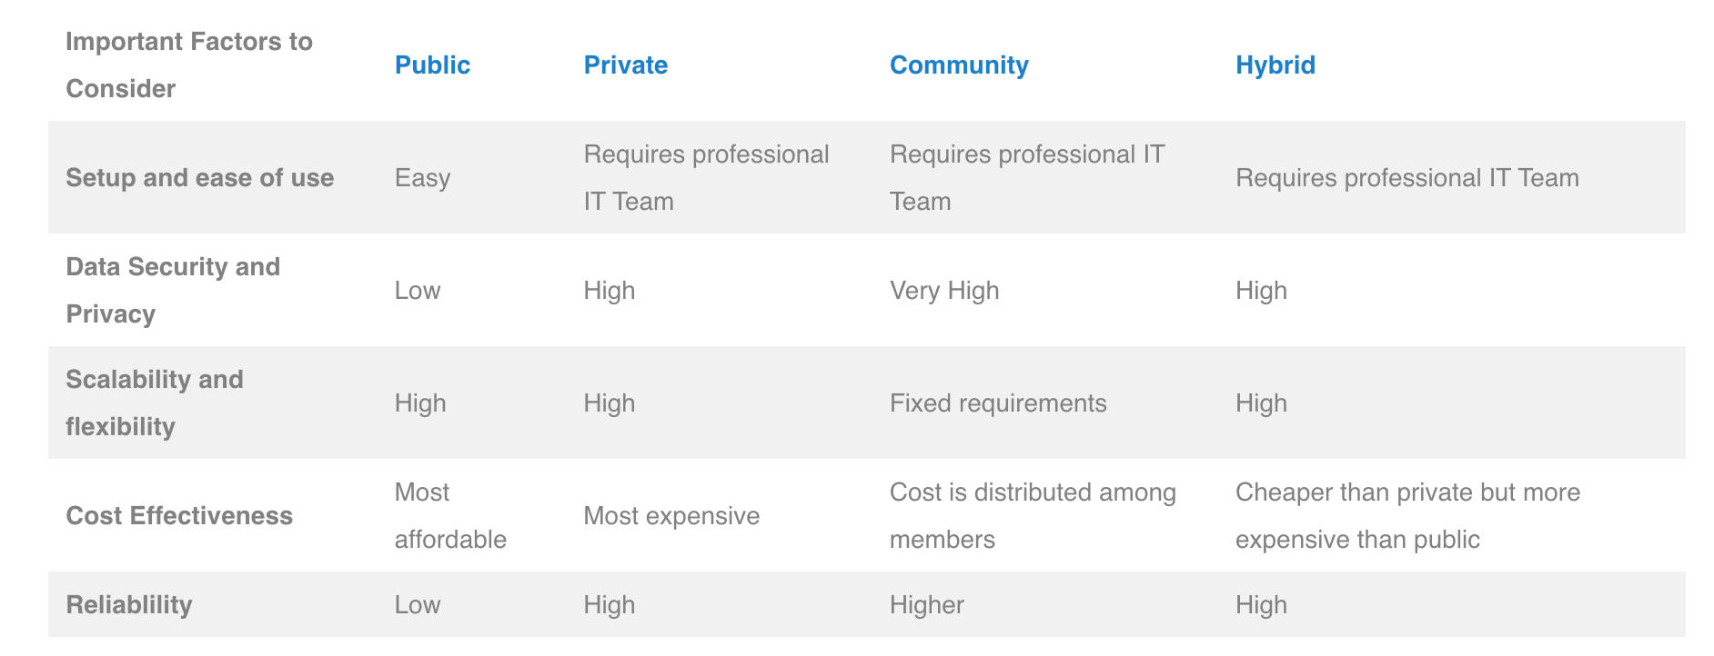
Comparison

